Slide 1
What is computer hardware ?
Computer hardware includes the physical parts of a computer, such as the case, central processing unit, random access memory, monitor, mouse, keyboard, computer data storage, graphics card, sound card, speakers and motherboard

Slide 3
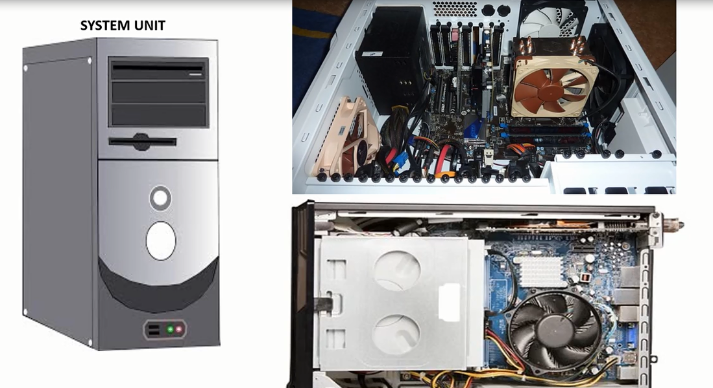
Internal hardware :
Internal hardware is the hardware inside the computer or is a device that is installed within the computer.

Slide 4
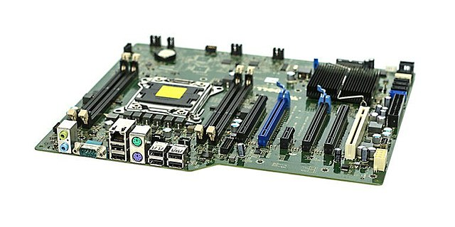
Motherboard is the central circuit board found inside the system units

Slide 5
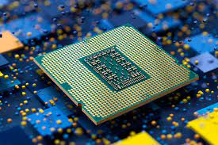
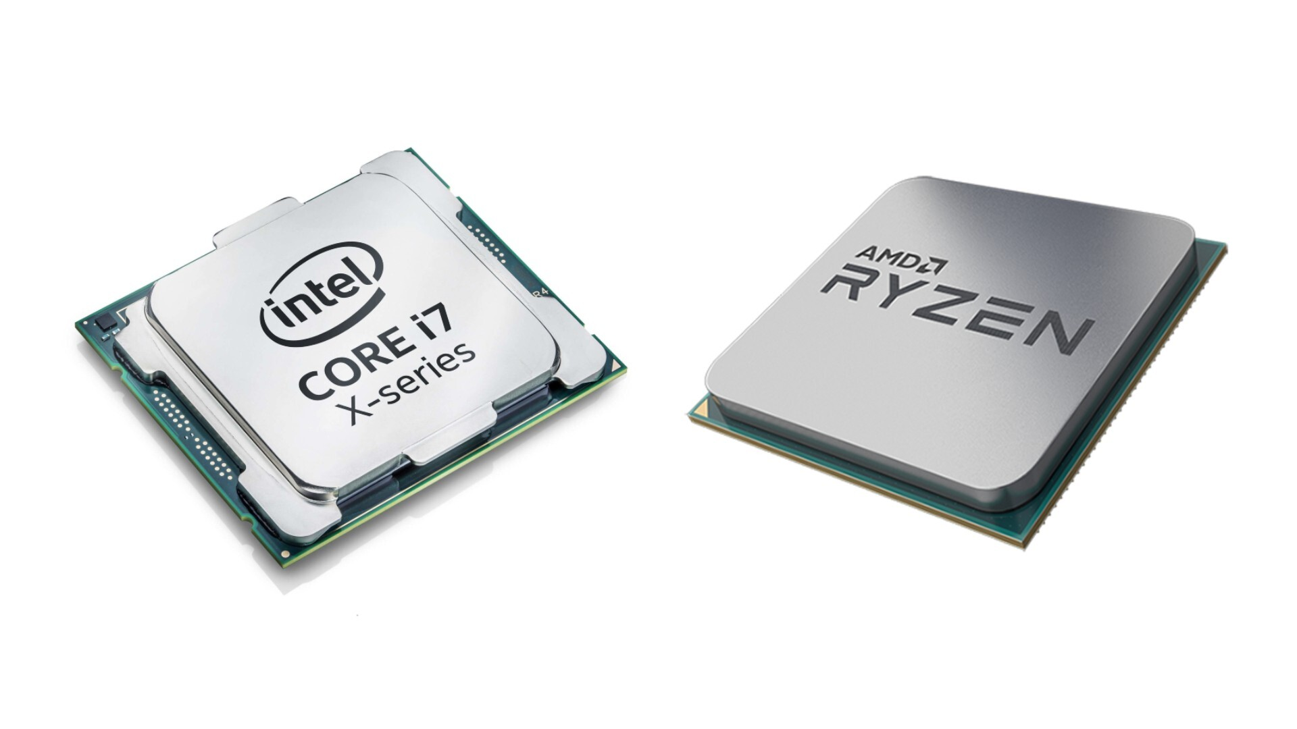
CPU
or other hardware are plugged into the motherboard. They are Central processing unit the CPU is the brain of the computer is responsible for all data processing. CPU is placed in cpu socket in the motherboard

Slide 6
RAM
ROM
Internal memory, also called "main or primary memory" refers to memory that stores small amounts of data that can be accessed quickly while the computer is running and both of them will fix in motherboard

Slide 7
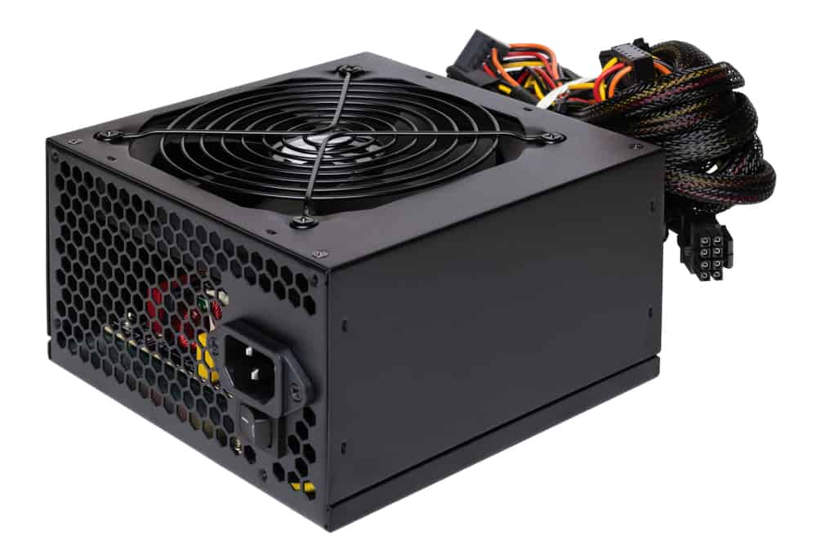
Power supply
Power supply sends power to the motherboard and other components

Slide 8
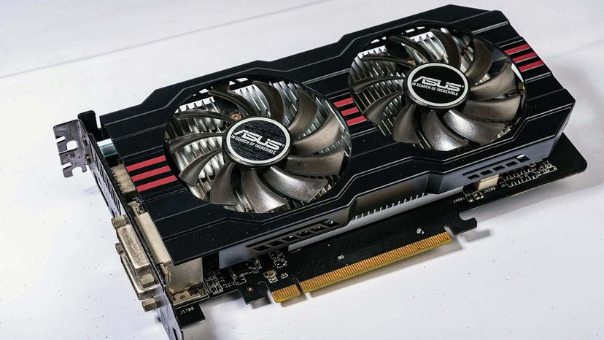
Graphics Cards
A graphics card is a device that attaches to the motherboard to enable the computer to process and display graphics

Slide 9
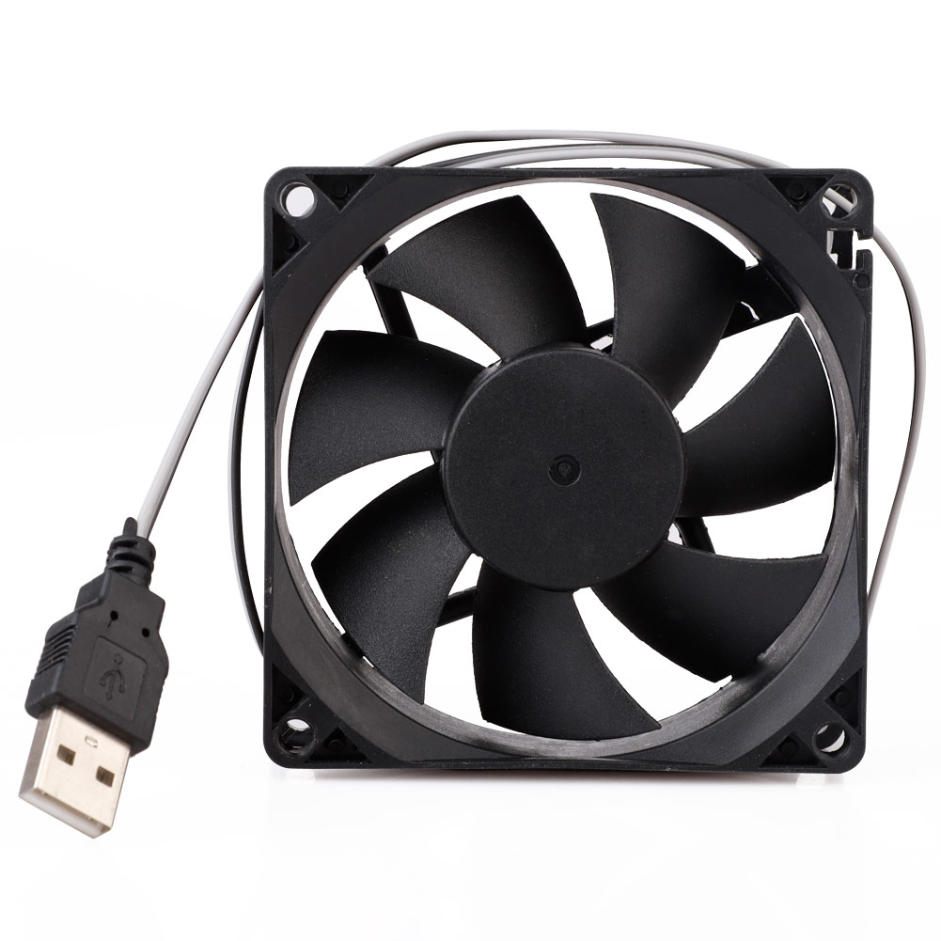
fan
It holds the CPU cold and doesn’t let CPU get over hitting

Slide 10
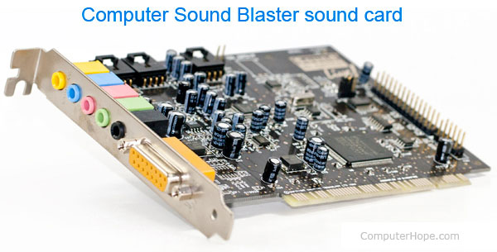
Sound card
Sound card enable computer to produce sound it also helps us to connect the microphone to computer system

Slide 11
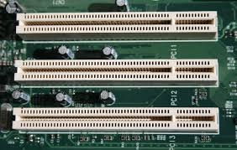
Expansion slot
it Could hold an expansion card like a video card network card or sound card to expand the functionality and its also places in motherboard

Slide 12
What is network card?
It provides the computer with a network
(internet connection ) either through wireless signals or a physical cable connection
What is sound card?
It’s a device that attaches to the motherboard to enable the computer to input, process, and deliver sound
What is graphics video card?
It’s a device that attaches to the motherboard to enable the computer to processes and display graphics

Slide 13
These are all connected to the motherboard

Slide 14
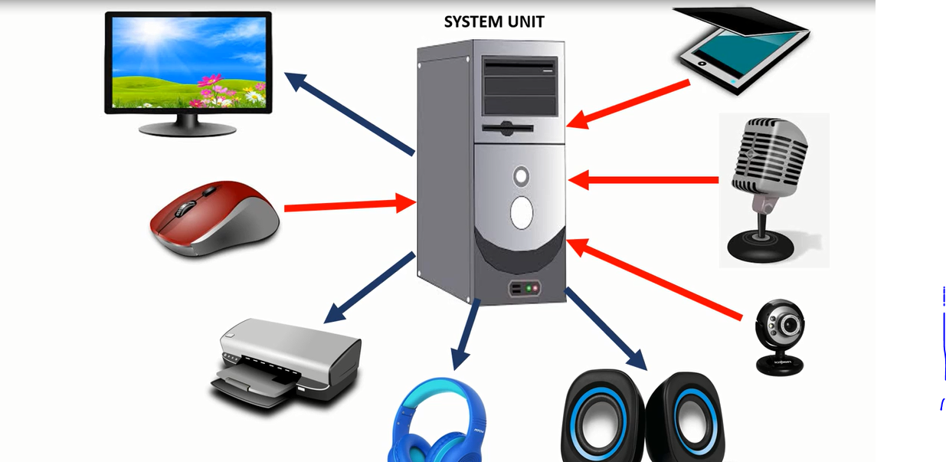
External hardware
They are connected to the system units ,external hardware devices will call PERIPHERAL

Slide 15
External hardware :
1-input devices
2-output devices
3-Storge devices

Slide 16
Input devices
Are use to enter data and instruction into the computer
Input Examples :

Slide 17
Output devices
Output devices receive the information from the computer and will give it to the user.
For example sound being played through a speaker
Output Examples :

Slide 18
storage devices
They use to store data
Storage Examples :

